Slide 1




COVER PAGE
Startup Name: DigitalGuard
Tagline: Your digital life, protected & future-ready.
Team Name: Dynamo
Team ID: EJ25T735273
Team Members: Mayank Raj, Atulya Jha, Lavanya Pataiya

Slide 2
PROBLEM
The Digital Footprint Crisis
Every post, comment, and share creates a permanent digital footprint.
But most teenagers believe “delete = gone,” even though deleted content still remains stored on servers and can resurface anytime.
Key Data & Statistics
  73% of teenagers regret something they posted online.
  Digital threats have increased by 42% year-on-year.
  85% of students lack any formal digital safety training in school.
  Teenagers spend 4–6 hours daily on social media, increasing exposure to risks.

Slide 3

SOLUTION
DIGITALGUARD: A COMPLETE DIGITAL SAFETY ECOSYSTEM
DIGITALGUARD SOLVES THE DIGITAL FOOTPRINT CRISIS BY COMBINING EDUCATION, REAL-TIME PROTECTION, AND INSTITUTIONAL MONITORING IN ONE PLATFORM. UNLIKE TOOLS THAT ONLY BLOCK CONTENT OR GIVE BASIC TIPS, DIGITALGUARD ACTIVELY GUIDES TEENS, PREVENTS UNSAFE POSTS, AND PROVIDES CLEAR ANALYTICS FOR SCHOOLS AND COMPANIES.
Unique Value Proposition
“Your digital life, protected & future-ready.”
Key Features & Advantages
  Real-time risky-post detection
  Privacy-first: no user data stored
  Teen-friendly awareness website
  Smart extension across major platforms
  Dashboards for schools & corporates
  Scales from individuals → institutions
  Unified ecosystem: learn + protect + analyze

Slide 4
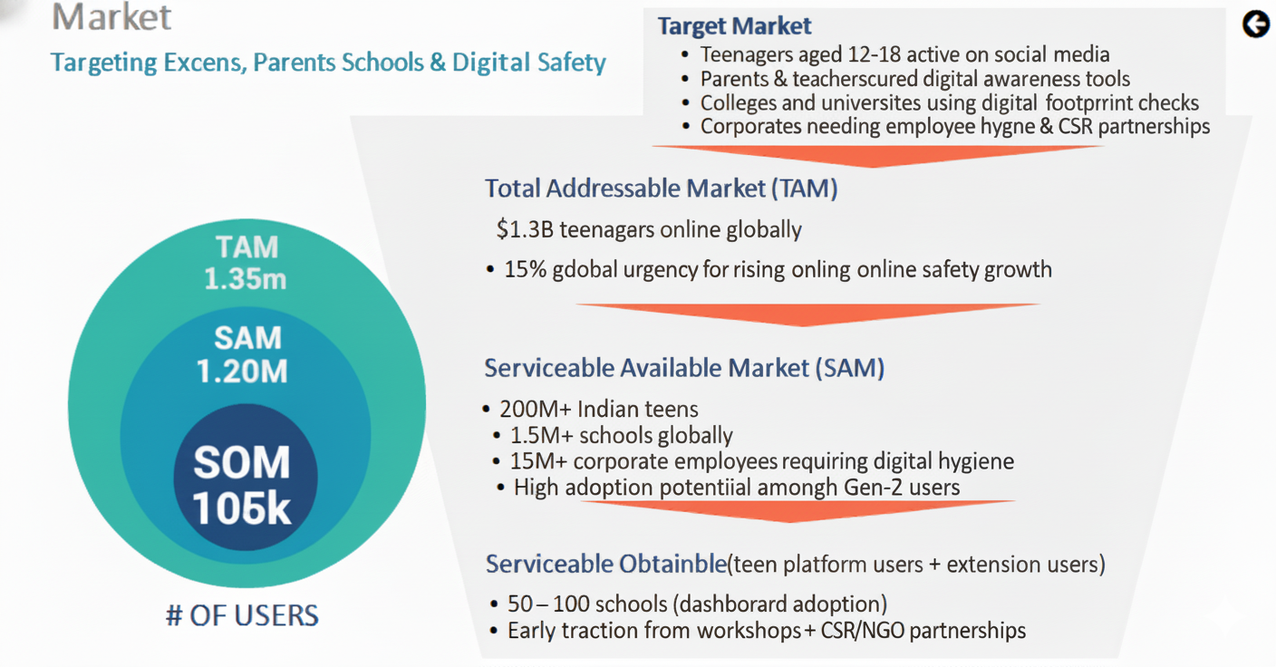
MARKET

Slide 5
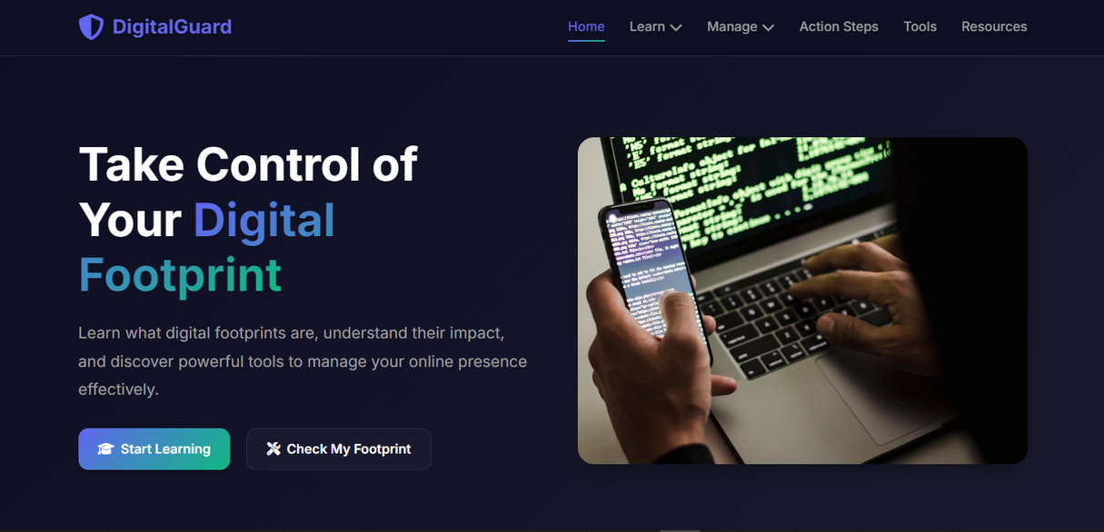
PRODUCT
WEBSITE (AWARENESS PLATFORM)
⭐ UNIQUE FEATURES & DIFFERENTIATION (WEBSITE – AWARENESS PLATFORM)
ONLY PLATFORM DESIGNED EXCLUSIVELY FOR TEENAGERS’ DIGITAL FOOTPRINT EDUCATION
USES SIMPLE EXPLANATIONS, REAL EXAMPLES, AND INTERACTIVE LEARNING (COMPETITORS MOSTLY GIVE LONG TECHNICAL ARTICLES)
FOCUSES ON PREVENTIVE AWARENESS, NOT JUST WARNINGS AFTER SOMETHING GOES WRONG
TEEN-FRIENDLY UI THAT MAKES LEARNING EASY AND ENGAGING, UNLIKE HEAVY CYBER-SAFETY PORTALS
PART OF A COMPLETE ECOSYSTEM (WEBSITE + EXTENSION + DASHBOARD) — COMPETITORS DON’T CONNECT AWARENESS WITH REAL-TIME PROTECTION

Slide 6
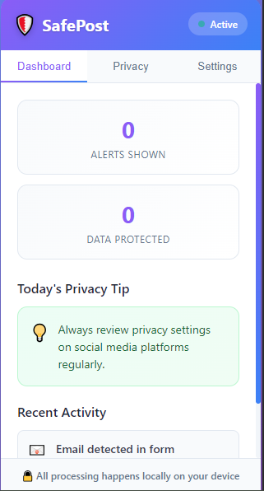
PRODUCT
BROWSER EXTENSION: SAFEPOST (PART 1)
⭐ SAFEPOST BROWSER EXTENSION — UNIQUE FEATURES & DIFFERENTIATION
DETECTS RISKY OR SENSITIVE CONTENT BEFORE YOU POST
INSTANTLY WARNS USERS ABOUT PERSONAL INFO, HARMFUL TEXT, OR UNSAFE ACTIONS
PROCESSES EVERYTHING LOCALLY, ENSURING ZERO DATA COLLECTION
TEEN-FRIENDLY UI WITH SIMPLE ALERTS AND GUIDANCE
HELPS BUILD SAFE POSTING HABITS THROUGH REAL-TIME FEEDBACK
DIFFERENTIATION FROM COMPETITORS:
MOST TOOLS ONLY SCAN AFTER A POST IS MADE — SAFEPOST WORKS BEFORE THE POST, PREVENTING DAMAGE
COMPETITORS TRACK USER DATA; SAFEPOST IS 100% PRIVACY-FIRST
BUILT SPECIFICALLY FOR TEEN DIGITAL SAFETY, NOT GENERIC CYBERSECURITY
WORKS SEAMLESSLY WITH THE DIGITALGUARD ECOSYSTEM (WEBSITE + DASHBOARD)

Slide 7
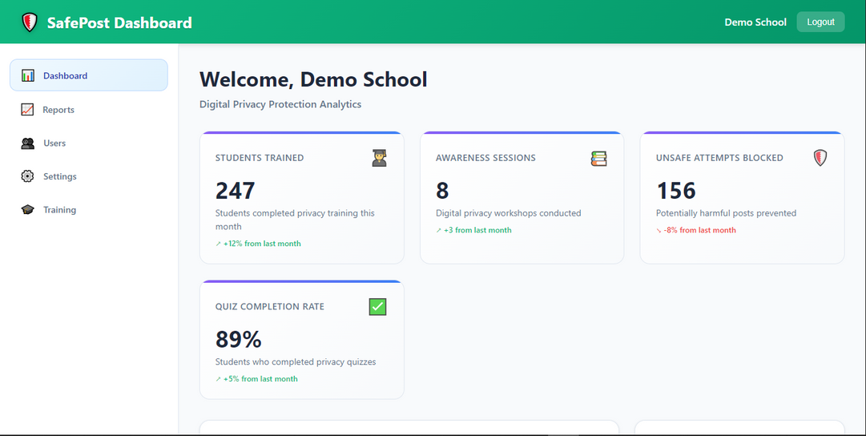
PRODUCT
INSTITUTIONAL DASHBOARD (PART 2)
⭐ INSTITUTIONAL DASHBOARD — UNIQUE FEATURES & DIFFERENTIATION
GIVES SCHOOLS AND CORPORATES CLEAN ANALYTICS ON DIGITAL HYGIENE TRENDS
SHOWS BEHAVIOUR INSIGHTS, ALERT PATTERNS, AND IMPROVEMENT PROGRESS OVER TIME
COMPLETELY PRIVACY-SAFE — NO PERSONAL MESSAGES, NO PRIVATE DATA, ONLY ANONYMIZED METRICS
HELPS INSTITUTIONS UNDERSTAND WHERE TEENS/EMPLOYEES NEED GUIDANCE
ENABLES INFORMED DECISION-MAKING FOR WORKSHOPS, TRAINING, AND AWARENESS DRIVES
DIFFERENTIATION FROM COMPETITORS:
COMPETITORS ONLY OFFER BLOCKING OR GENERIC MONITORING; OUR DASHBOARD GIVES ACTIONABLE INSIGHTS
DESIGNED FOR EDUCATION + AWARENESS, NOT SURVEILLANCE
WORKS SEAMLESSLY WITH THE SAFEPOST EXTENSION TO PROVIDE A FULL ECOSYSTEM VIEW
FIRST DASHBOARD BUILT SPECIFICALLY FOR THE DIGITAL-FOOTPRINT CRISIS, NOT JUST GENERAL CYBER TOOLS

Slide 8
REVENUE
MODEL
REVENUE MODEL (DIGITALGUARD)
HOW WE GENERATE REVENUE
1. SUBSCRIPTION & SAAS REVENUE
ENTERPRISE DASHBOARD LICENSES FOR SCHOOLS & COLLEGES (ANALYTICS + TRAINING).
CORPORATE B2B SUBSCRIPTION FOR EMPLOYEE DIGITAL-SAFETY MONITORING.
DIGITALGUARD PREMIUM FOR STUDENTS & PARENTS (AI RISK DETECTION + SAFEPOST PRO FEATURES).
2. ADVERTISING & SPONSORED CONTENT
WEBSITE + EXTENSION ADS (ADSENSE / SPONSORED SAFETY POSTS).
3. GAMIFICATION & MICRO-TRANSACTIONS
DIGITAL BADGE SHOP (ACHIEVEMENT BADGES, PROFILE BOOSTERS, PREMIUM ADD-ONS).
4. CERTIFICATION & LEARNING PROGRAMS
PAID DIGITAL FOOTPRINT CERTIFICATION COURSES (₹200–₹500).
5. CSR PARTNERSHIPS & SPONSORSHIP FUNDING
COLLABORATIONS WITH CSR INITIATIVES SUPPORTING TEEN SAFETY & DIGITAL WELLNESS.

Slide 9
REVENUE
MODEL
🟩 PRICING STRATEGY
FREEMIUM MODEL → FREE AWARENESS + PAID PROTECTION & ANALYTICS.
LOW-COST STUDENT PLANS, HIGH-MARGIN INSTITUTIONAL LICENSES
.
🟧 CUSTOMER ACQUISITION
SCHOOL TIE-UPS, STUDENT COMMUNITIES, CORPORATES, ONLINE CAMPAIGNS.
🟪 PATH TO PROFITABILITY
RECURRING SAAS INCOME + LOW OPERATING COST → FAST SCALABILITY.
MULTIPLE REVENUE STREAMS ENSURE STABLE LONG-TERM GROWTH.

Slide 10
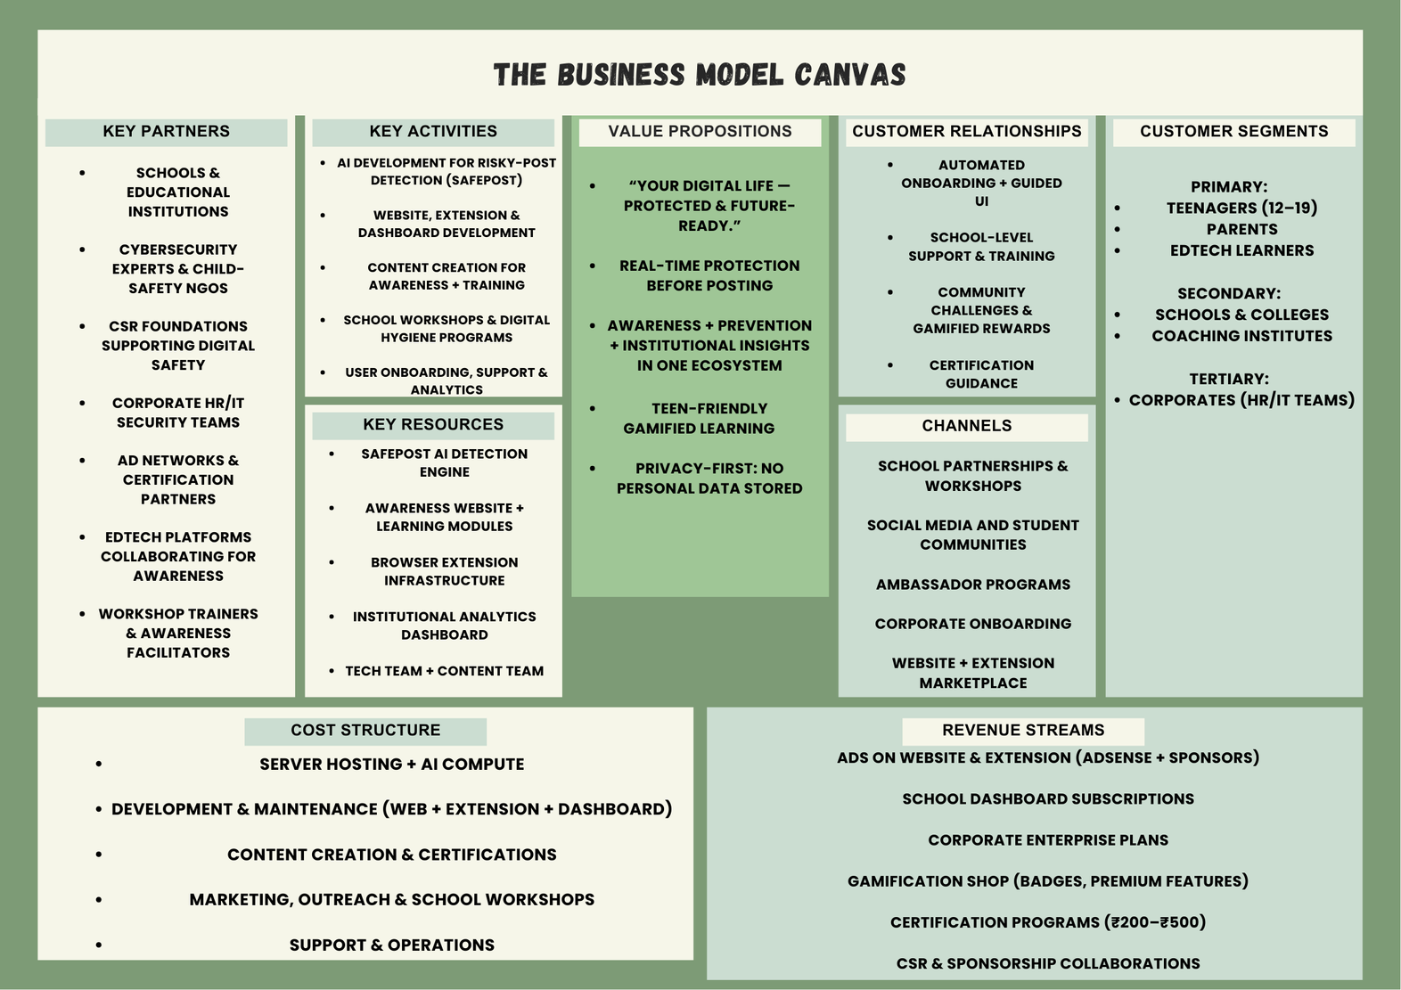
BUSINESS MODEL CANVAS

Slide 11

THANK YOU
Team name: Dynamo
Eureka! Team ID: EJ25T735273

